Slide 1

Department of Computer Science Gujarat University
5 Year Integrated M.Sc.(Computer Science)
Semester - III
GAME -O- MENIA
Presented By:
Mansuri Aasima (18)
Vachheta Jinal (58)
Patoliya Drashti (32)
Gohel Shreya (09)
Under the Guidance of :
Dr. Bhumika Shah

Slide 2

Table of Content
Project Profile
Tools and Technologies used
Derived work
Project Description
Objective
Screenshots / Animation
Related Work
Conclusion
Bibliography

Slide 3
Project Profile
Title | Description
Project | Game -O- Menia
IDE | Visual studio code
Team size | 4 members
Team members | Mansuri Aasima (18) Vachheta Jinal (58) Patoliya Drashti (32) Gohel Shreya (09)
Guide | Dr. Bhumika Shah
Project duration | 6 Months

Slide 4
Tools and Technologies used
Tools :-
Visual studio code
Ms Paint
Ms Paint 3d
Github
Technologies :
HTML
CSS
JAVA SCRIPT

Slide 5
Derived work
Drashti:
score tracking logic of stone paper scissors
rock paper scissors’s javascript
shreya:
homepage css and layout
Css of whack a mole

Slide 6
Derived work
jinal:
Whack a mole javascript
Images from paint 3d of whack a mole and stone paper scissors
Keyframe of birds in hunting birds
Git-hub management
Aasima:
Hunting bird javascript
Logic of appearance of mole and plant
Images from paint 3d of hunting bird and backgrounds

Slide 7

Project description
“GAME-O-MENIA” is an web game with many sub-games like :
Hunting bird
Whack a mole
Stone paper scissor

Slide 8
Game Description
1)Hunting bird
Introduction
Welcome to Hunting Bird Game!
Hunting Bird is a shooting game in which players have to shoot down the birds that appear on the screen. This game is designed to test your shooting skills. With each successful shot, the player is rewarded with points.

Slide 9
Hunting bird(cont.)
Introduction
When a user shoots the ordinary bird, the user will get 1 points, and when the user shoots the bonus bird, the user will get 5 points. If the user misses the shot, the score will decrease by 1 point.
The goal of the game is to shoot as many birds as possible in 30 seconds.
The counter shows how many targets you hit in the 30 seconds.
There is no limit in bullets

Slide 10

Hunting bird(cont.)
Image

Slide 11
Hunting bird(cont.)
How to play
Use your mouse to aim at the birds on the screen. Click the left mouse button to shoot.
Try to shoot as many Birds as possible within the 30-second time limit.
Keep an eye on the counter to see how many birds you've hit during the game

Slide 12
Game Description
2)Whack a mole
Introduction
we have designed a web-based Whack-a-Mole game using Html, Css and Javascript.
The appearance of mole and plant are randomized, providing an unpredictable challenge for players.
The game's functionality is powered by JavaScript, which controls the mole animations, plant animation, and score tracking.
one user can play game at a time

Slide 13
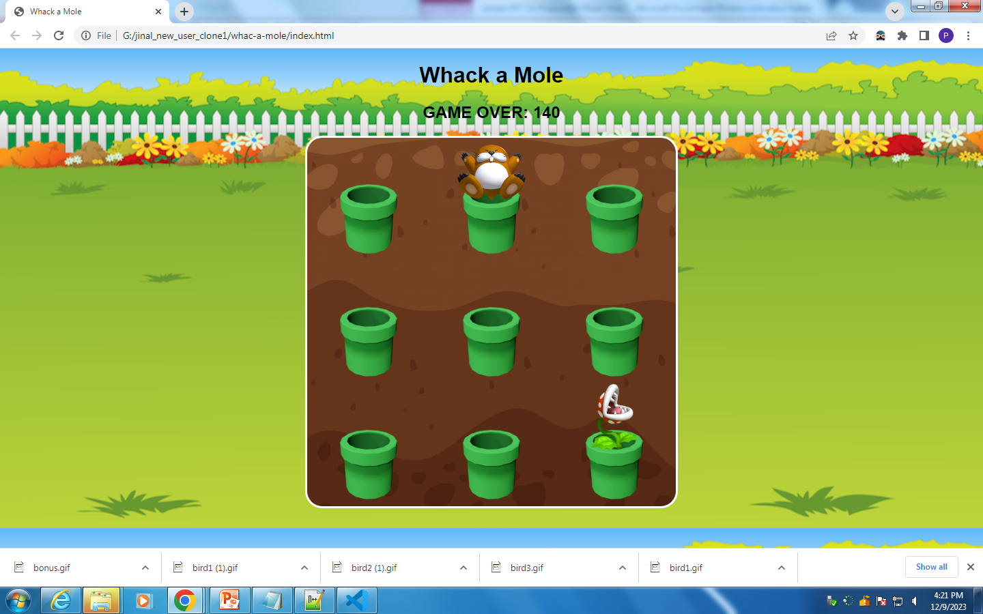
Whack a mole(cont.)
Image

Slide 14
Whack a mole(cont.)
How to play
Mole and plant pop up from different holes at varying intervals
Players use their mouse to interact with the game, clicking on moles to whack them.
Each successful whack earns 10 points for player, but if player click on plant then game will be over

Slide 15
Game Description
3)Stone paper scissors
Introduction
Welcome to the world of Rock, Paper, Scissors!
Explore the magic behind the scenes powered by
→ HTML for structure
→ CSS for style
→JavaScript for dynamic interactivity.

Slide 16
Stone paper scissors(cont.)
simple rules of Rock, Paper, Scissors
Rock crushes scissors.
Scissors cuts paper.
Paper covers rock.
How to play
Players make their choice by clicking on the virtual representations of Rock, Paper, or Scissors.
Face off against a computer opponent programmed to make randomized choices.
The game's logic determines the winner based on the classic Rock, Paper, Scissors rules.

Slide 17
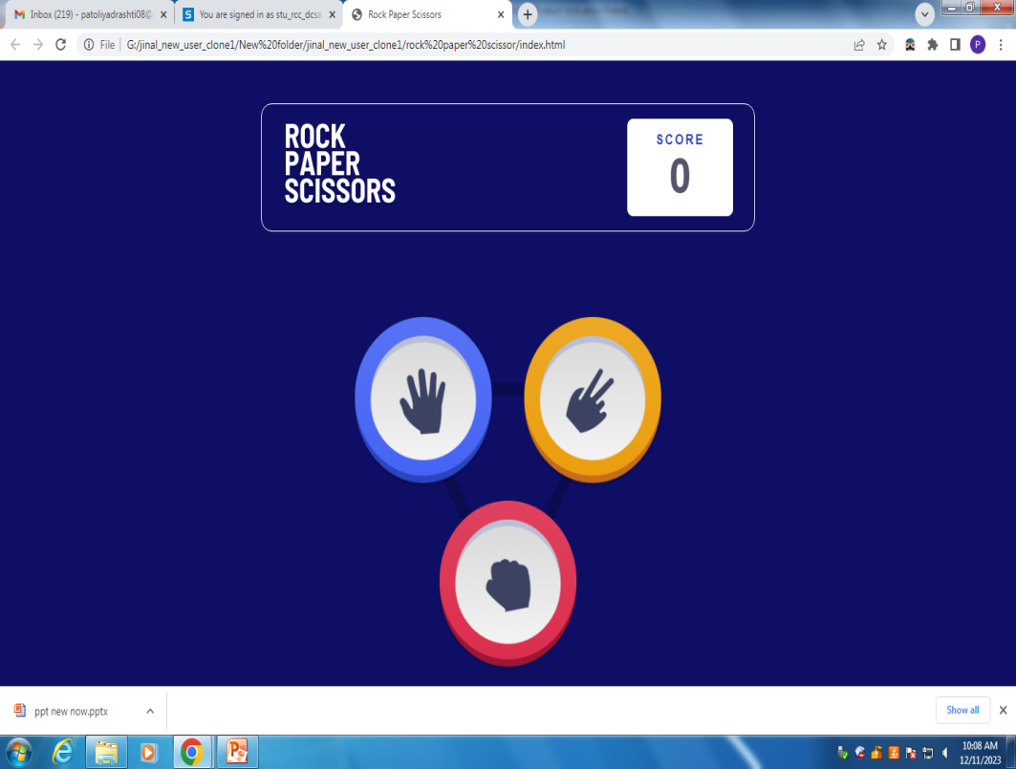
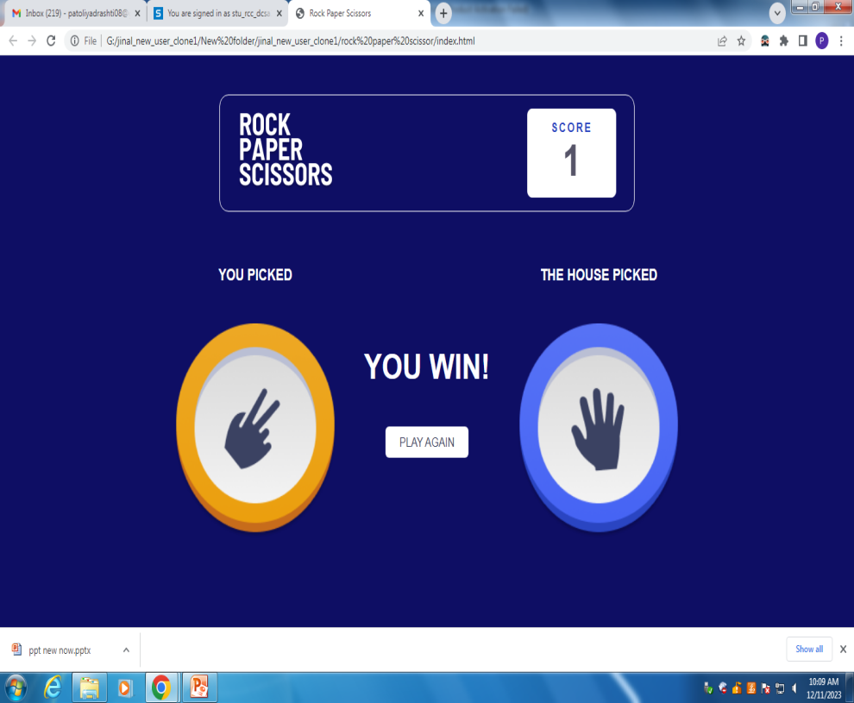
Stone paper scissors(cont.)
Image

Slide 18
Objective
Demonstrate how these technologies can be integrated to create a dynamic engaging game emphasizing user interaction for responsiveness .
“Hunting bird” typically aims to simulate hunting skills in virtual environment .
“Stone paper scissors” is a chance-based decision game, showcasing decision-making in uncertain situations.
“whack a mole” is to test hand-eye coordination by quickly hitting emerging moles.

Slide 19
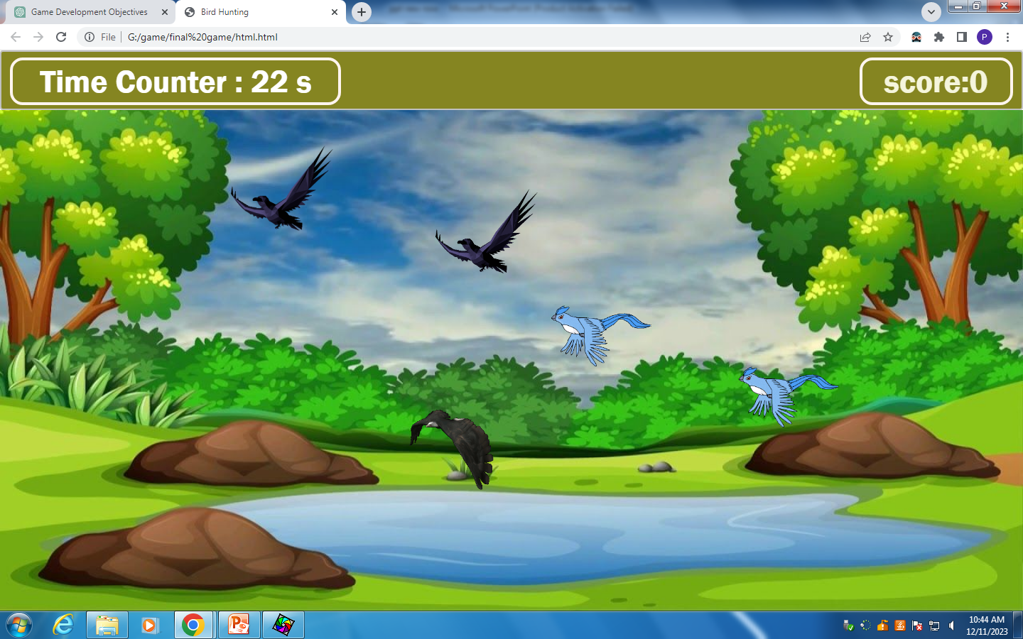
Screenshots / Animation
1) Hunting bird

Slide 20

Screenshots / Animation
3) Whack a mole

Slide 21
Screenshots / Animation
3)Stone paper scissors

Slide 22
Related work
Hunting bird game
Duck Hunt is a fantastic arcade game that takes inspiration from the original classic available on Nintendo game systems. You must shoot the moving ducks down with your mouse and see how many points you can score.
The hunting is fun and the controls to aim and fire your weapon are simple to master. The graphics are reminiscent of early Nintendo consoles and the gameplay really is fun. Be sure to avoid shooting your faithful dog, and aim your weapon fast!
Release Date
The HTML5 version has been available since April 2019.
This version is made by Matthew Surabian is inspired by the Nintendo game.

Slide 23
Related work
Stone paper scissors
The popular classic game Rock Paper Scissors is now live with a realistic theme. You can make various 3 symbols that are Rock Paper and Scissors. Each symbol is superior to another. This game is also well known as Roshambo. By guessing the opponent's moves, you can beat him/her.

Slide 24
Related work
Whack a mole
Whack-A-Mole is an arcade game. It was created in 1975 by the amusements manufacturer TOGO in Japan, where it was originally known as Mogura Taiji (モグラ退治, "Mole Buster") or Mogura Tataki (モグラたたき, "Mole Smash").

Slide 25
Conclusion
Know the latest technology and tools.
how to Improved game quality Greater Flexibility
How to Increased Creativity Testing Phase
Include game design, scripting, creation of digital assets, animations, understanding hardware, problem solving, critical thinking, collaboration, and project management

Slide 26
Bibliography
(w3 school)html
https://www.youtube.com/watch?v=hKB-YGF14SY&t=9341s
(Canvas videos)
https://www.youtube.com/watch?v=4V0-YpO-KZo&t=1221s
(Paint 3d videos)
https://bvres.org/pdf_files/Tutorial_PDF/Beginning_Microsoft_Paint_3D.pdf

Slide 27
Bibliography
Java t point
https://www.w3schools.com/js/default.asp
Git and github(learning)
https://youtu.be/Uz_mTOQL9Tw?si=1F7joZ5gJv_xnlkY
Git profile
https://github.com/jinal-58-vachheta/project-game-o-menia?tab=readme-ov-file#readme

Slide 28
Thank you

